Slide 1
Server side request forgery (SSRF)
By Ebrahim Hegazy

Slide 2
Agenda
What is Server-side request forgery (SSRF)?
External service interaction (HTTP)
External service interaction (DNS)
SSRF to Local file disclosure
SSRF to RCE
Cloud providers meta files (AWS, Google cloud, Digital Ocean)
Gopher with Redis → RCE https://github.com/swisskyrepo/SSRFmap
SSRF security bypassing techniques
Domain pointing to localhost
IP to hex-decimal (Long IP)
Inet_aton() address translation

Slide 3

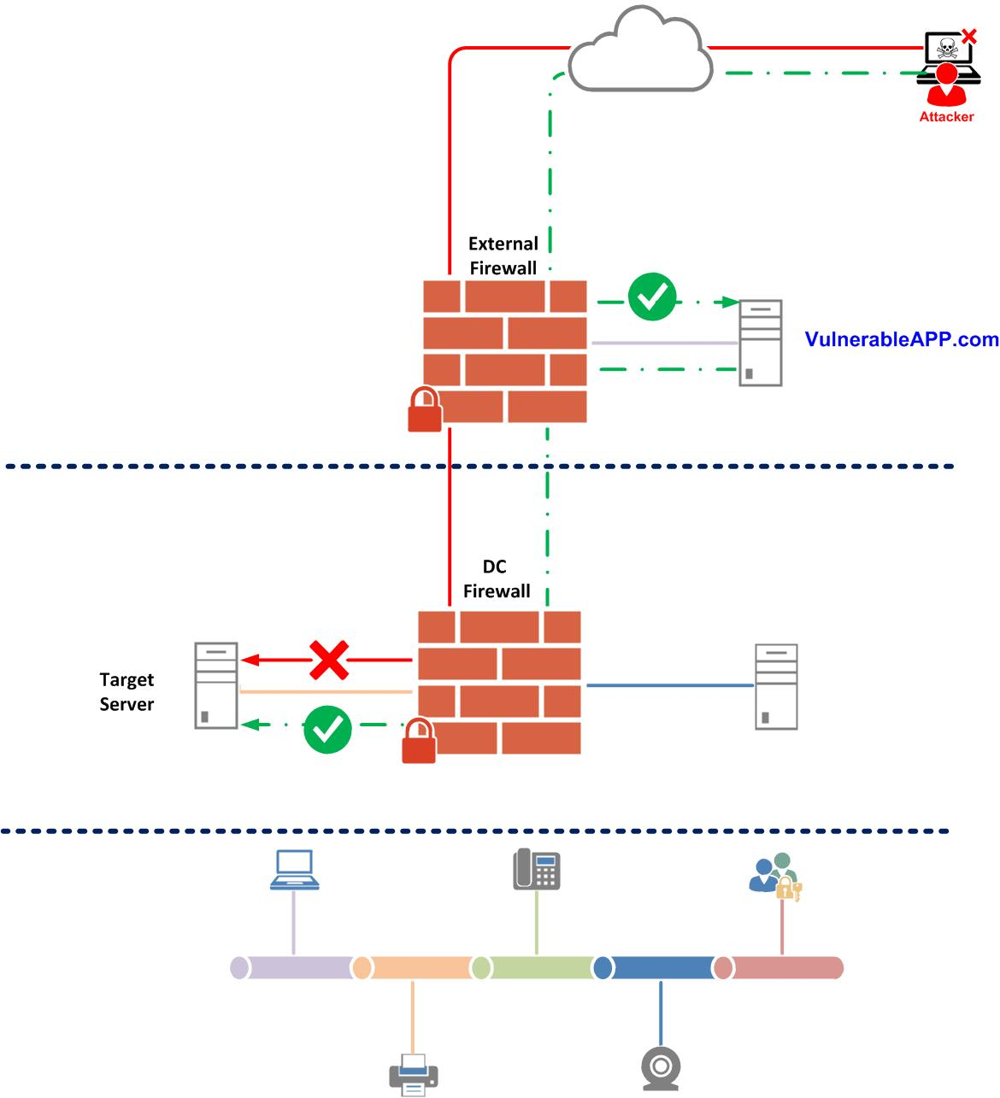
What is SSRF
In a Server-Side Request Forgery (SSRF) attack, the attacker can abuse functionality on the server to read or update internal resources. The attacker can supply or a modify a URL which the code running on the server will read or submit data to, and by carefully selecting the URLs, the attacker may be able to read server configuration such as AWS metadata, connect to internal services like http enabled databases or perform post requests towards internal services which are not intended to be exposed.
Types of SSRF:
The one which displays response to attacker (Basic)
The one which does not display response (Blind)

Slide 4
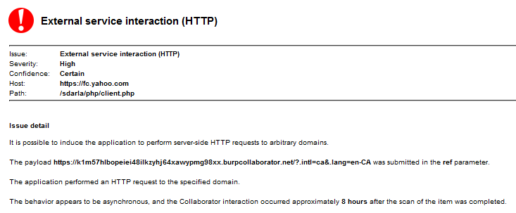
External service interaction (HTTP)
لا تعتبر SSRF
تسمح للمهاج بإستخدام السرفر المصاب في ارسال ركوستات إلي مواقع خارجية
تضر بسمعة الشركة المصابة ولكن ليس لها ضرر مباشر علي منظومة الشركة
يمكن إستغلالها في الهجوم المعروف بإسم
Cross Site Port Scanning (XSPS)
مثال علي خدمة جوجل للترجمة:
https://feedback.googleusercontent.com/gadgets/proxy?container=fbk&rewriteMime=image/*&url=

Slide 5
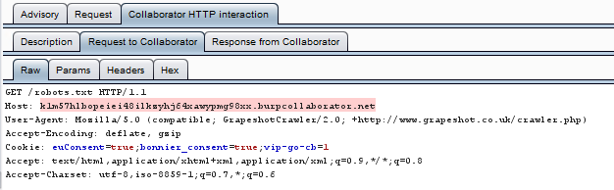
External service interaction (DNS)
لا تعتبر ثغرة للأسف
تحدث بسبب:
HTTP interaction
A reverse proxy tries to resolve the hostname
A third-party analytics service

Slide 6
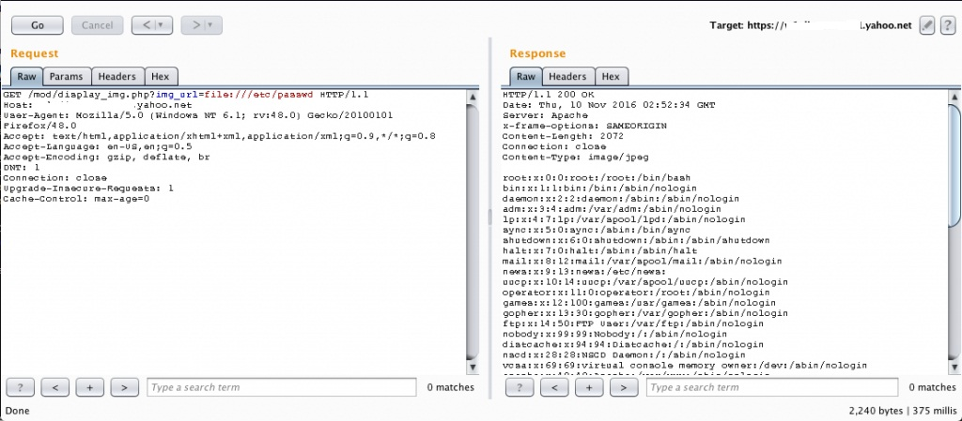
SSRF to Local file disclosure
SSRF can (in some cases) be exploited to read local files, using for example PHP Wrappers.
http://www.sec-down.com/wordpress/?p=696

Slide 7
SSRF to RCE (1)
Cloud providers users Metadata files to store sensitive information of the service user, such as SSH keys. These data is only accessible on the local network of the running instance.
AWS → http://169.254.169.254/latest/meta-data/
Google → http://metadata.google.internal/computeMetadata/v1beta1/project/attributes/ssh-keys?alt=json
Digital Ocean → http://169.254.169.254/metadata/v1.json

Slide 8
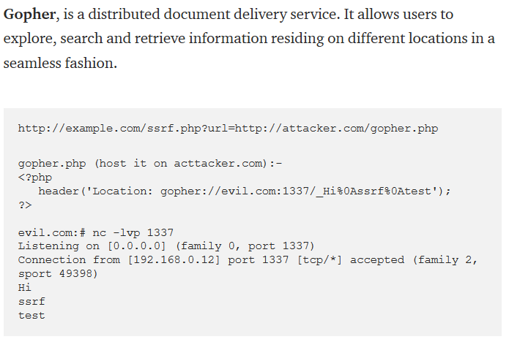
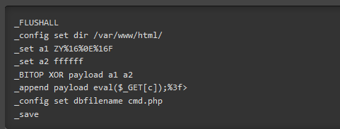
SSRF to RCE (2)
If the vulnerable server have Redis installed, it is possible to trigger RCE using Gopher. Refference: https://github.com/swisskyrepo/SSRFmap

Slide 9
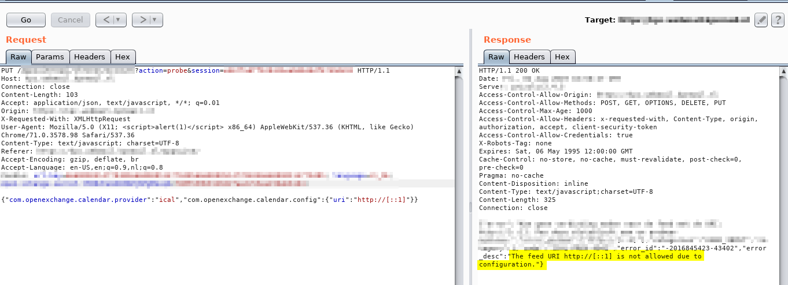
SSRF security bypassing techniques
Domain pointing to localhost (inside.sec-down.com)
IP to hex-decimal (Long IP)
Inet_aton() address translation
Request the company domain itself (i.e. the corp domain)

Slide 10

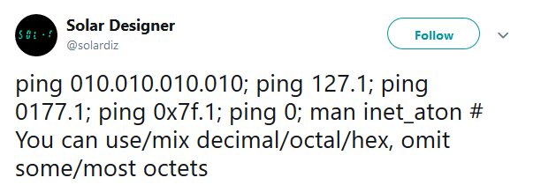
Inet_aton

Slide 11
Questions?
هناك جروب علي الفيس بوك مخصص لأسألة الدروس:
https://www.facebook.com/groups/pentesting4arabs/

